Slide 1



Home Together
Presented by Group B
Jaden Balogh
Alvin Putra
Athena An

Slide 2
Software Description
Home Together is a hub to help find people and services related to home sharing.
Features:
Information pages (home, about, footer)
Search pages (members and listings)
Signup and profile pages (members and businesses)
Listing management pages (view, edit, create, delete)
Individual view pages (member, listing)

Slide 3
The future of HomeTogether.ca
Future features:
Messaging system
Reviews/ratings for listings
Block/report other members
PayPal payment option for posting classifieds
Admin panel
Ban users, export site data, verify businesses, etc.

Slide 4
The future of HomeTogether.ca
Code and documentation can be found in our GitHub repository:
https://github.com/JadenBalogh/home-together-b
Transition requirements:
See transition documents and GitHub documentation for code setup
Hosted website can be transferred to new owner

Slide 5
Summary
We learned a lot along the way!
Using modern web development frameworks
Hosting a live website with Heroku
Working with a client
Dealing with all the obstacles that come up throughout a software project...

Slide 6
Target Audience
1. Users who are looking for housemates.
These users will be searching by criteria for other users to live with.
2. Users who are looking for services.
These users will be browsing the classifieds to find local services and events.
3. Businesses who are selling services.
These businesses will be paying the site to advertise their services.
4. Nonprofits listing their events and services.
These groups will be listing their events for free once verified.
Notes:
Home Together has 4 groups of target audience. The first group is users who are looking for housemates. The second group is users who are looking for services. the third group is Businesses who are selling services. The fourth group is Nonprofits listing their events and services.

Slide 7
Requirement
Unimplemented Features
A messaging system between users
A system for reviewing and rating listings
The ability to block or report users
A PayPal payment option for posting classifieds
Various admin features
Implemented Features
Users can view and search for the information
Users can signup and create profiles
Users can post the listings and manage them
We did not implement the map feature, which is no longer required by the client.

Slide 8
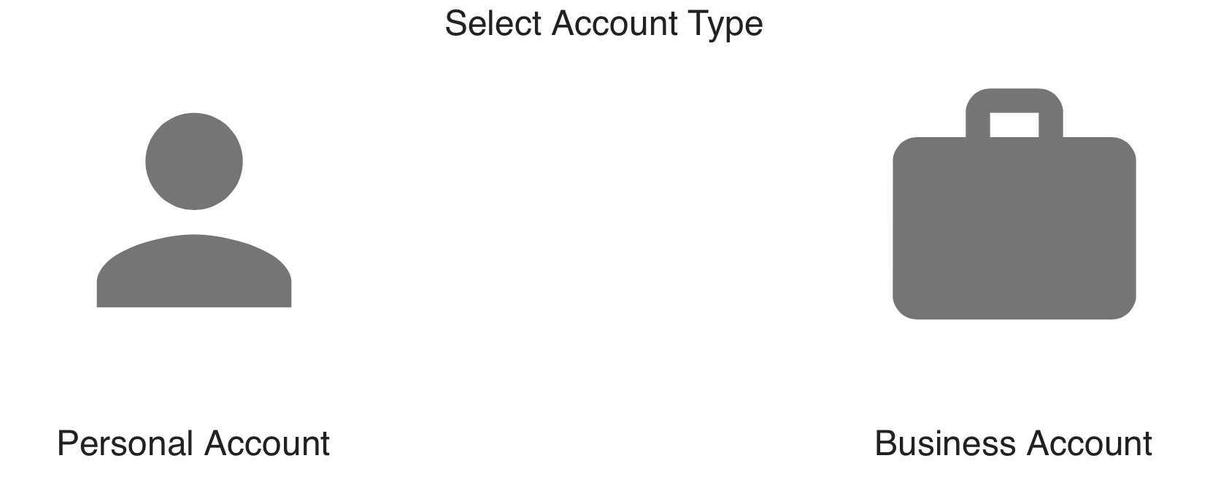
Design
The client required our team to design the website by ourselves.
We placed the required pictures and texts sent by the client in the website.
Navigation bar
Signup form
Two options to select from: personal or business account
Notes:
I am going to show you some designs about our design.

Slide 9

About and contact information for Home Together

Slide 10
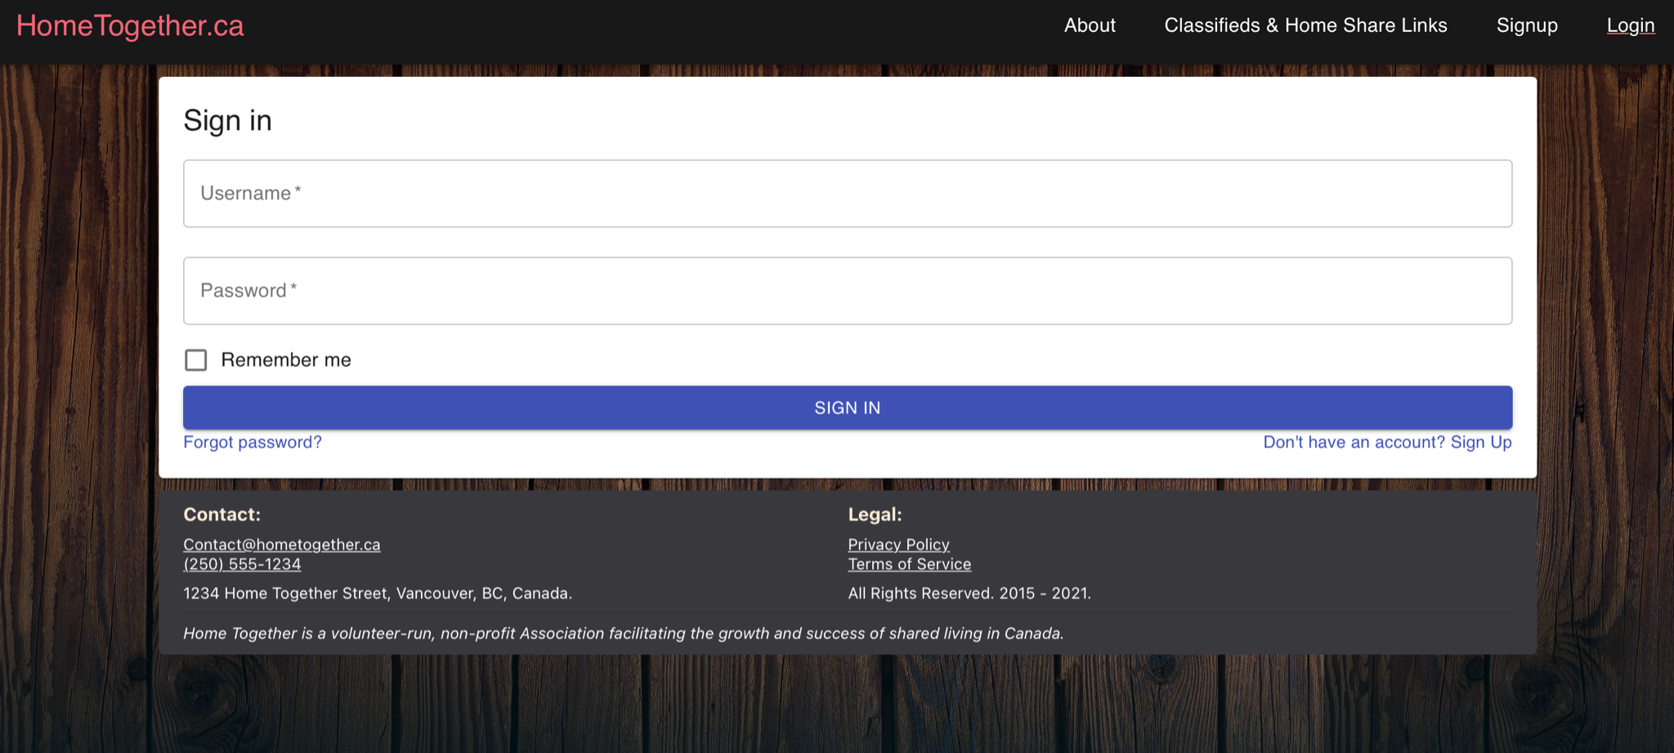
Login page

Slide 11
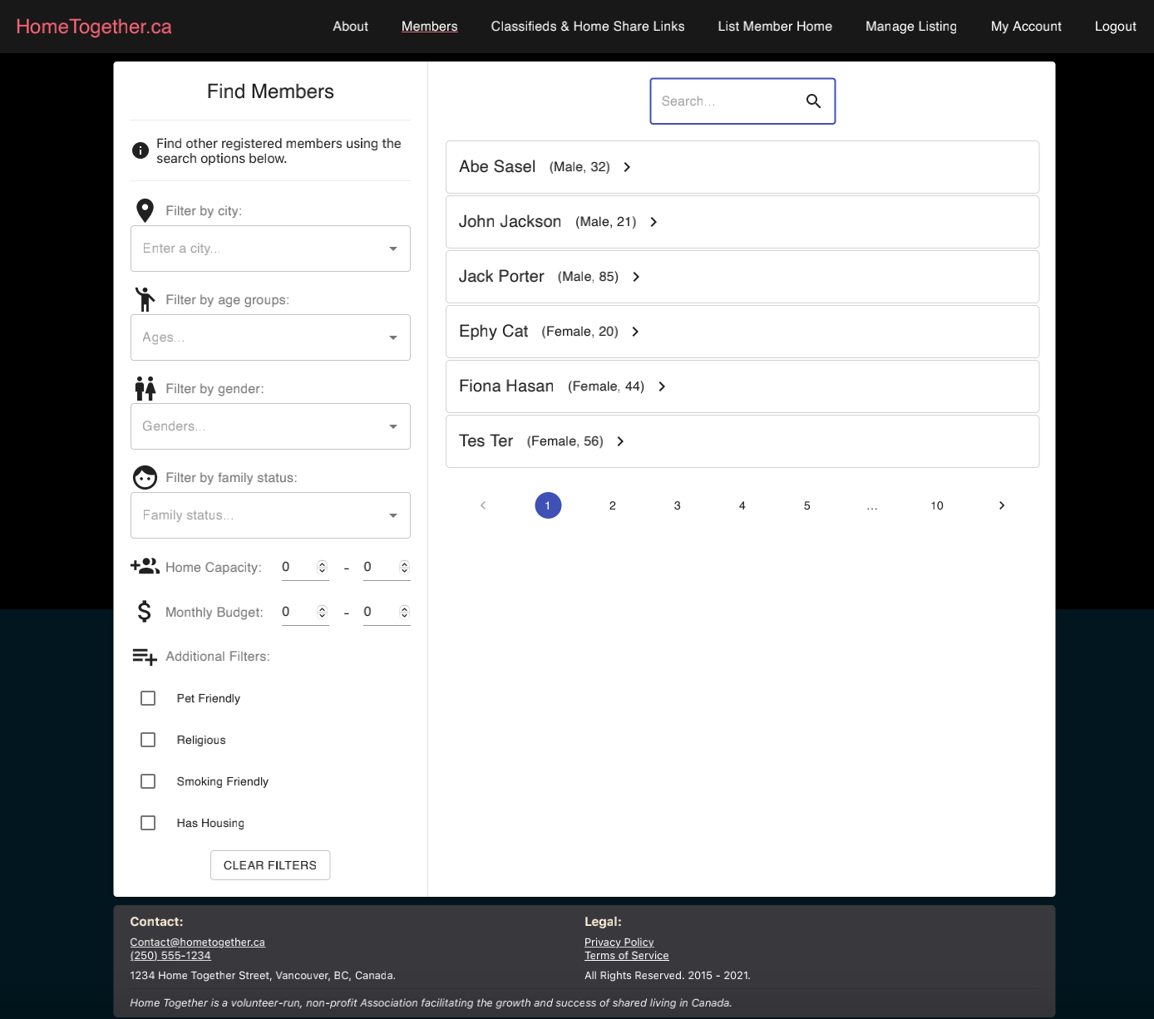
Member search page

Slide 12
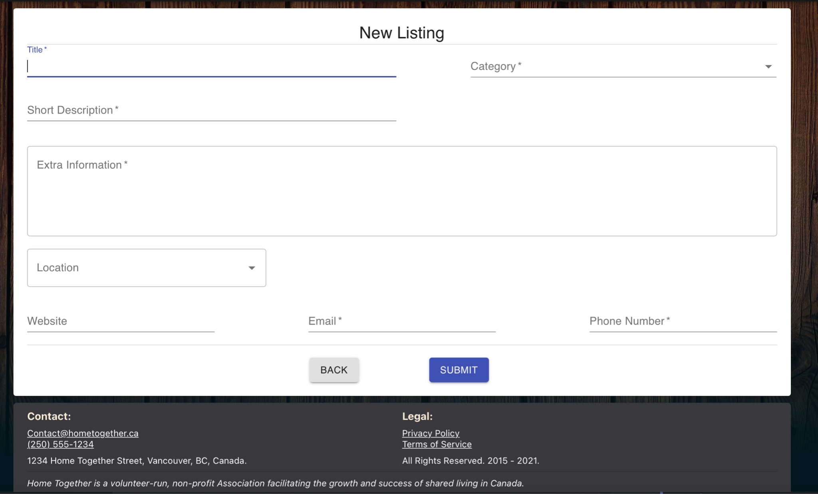
Listings creation page

Slide 13
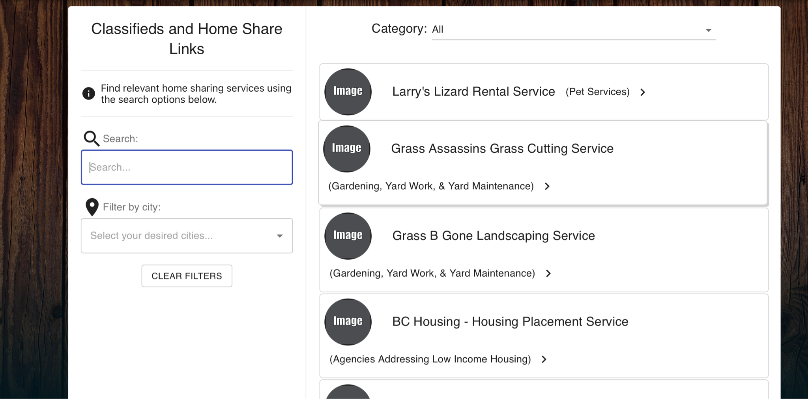
Listings search page

Slide 14
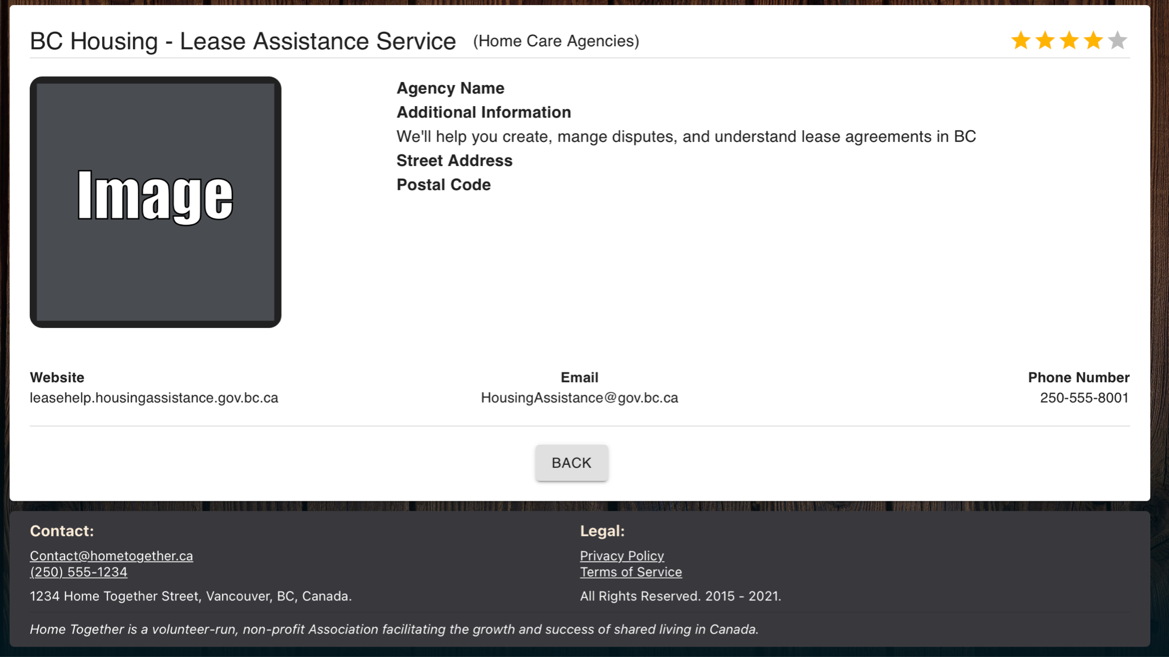
Listing details component with rating system and contact information

Slide 15
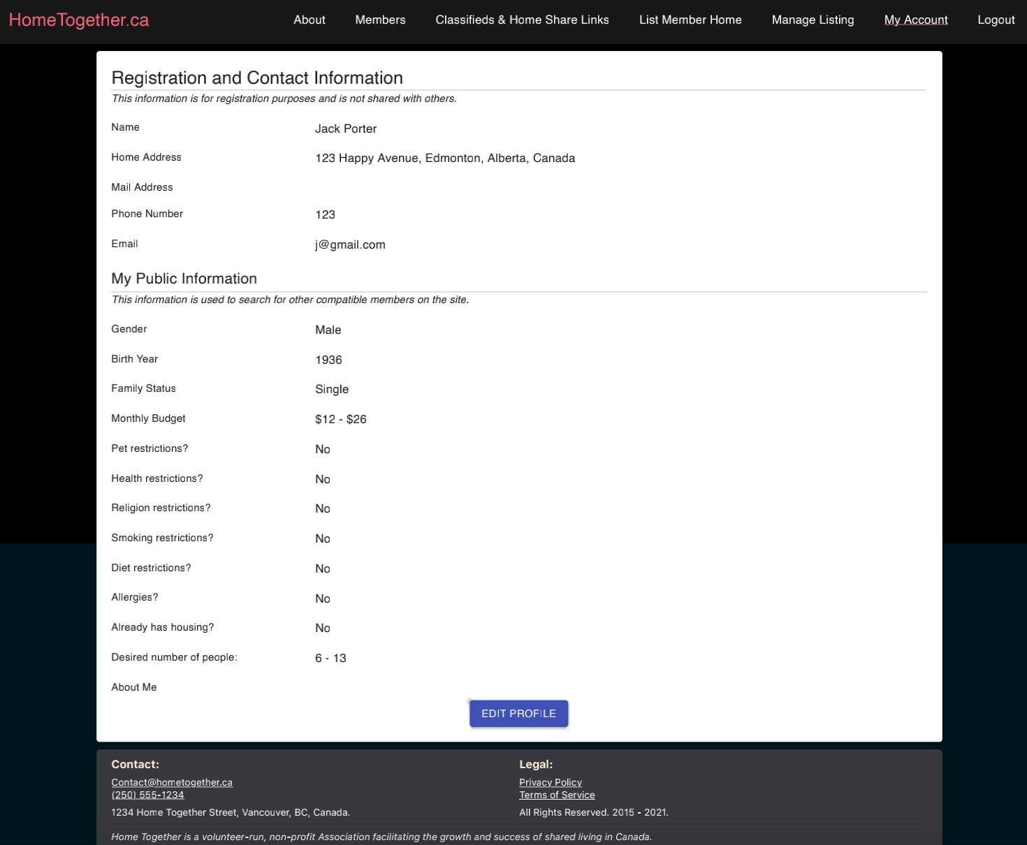
Profile view page for logged-in members

Slide 16
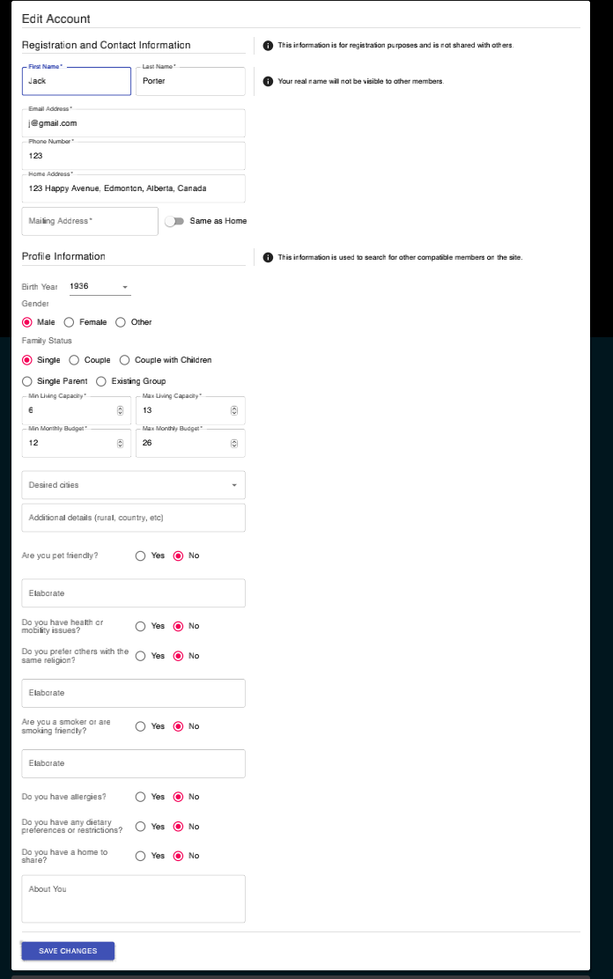
Edit profile page

Slide 17
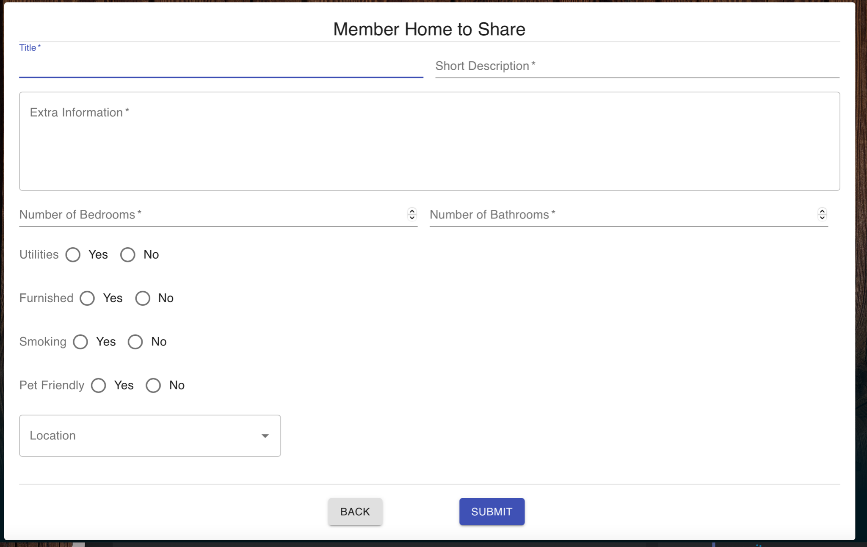
Member ads creation page

Slide 18
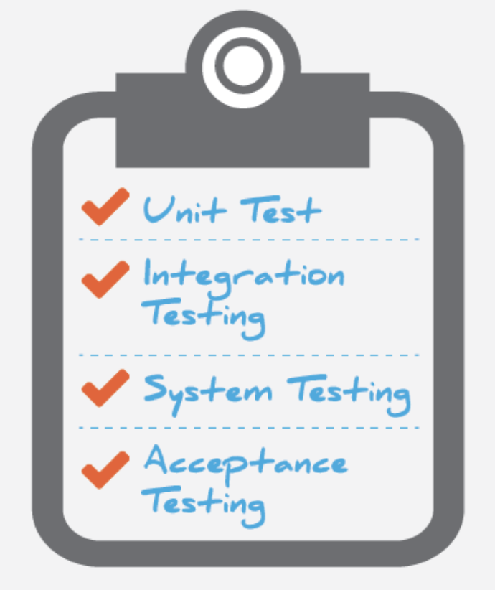
Testing
We did testing and dealt with the bugs that are the priorities in the final milestone.
The site has been thoroughly tested in its current iteration.
All pages are still subject to change and may require additional testing.
The view, edit and create pages for listings in particular still require an additional visual pass.
Notes:
We did testing and dealt with the bugs that are the top priority in the final milestone.
The site has been thoroughly tested in its current iteration.
As the site is still in-development, all pages are still subject to change and may require additional testing as more features are added.
The view, edit and create pages for listings in particular still require an additional visual pass which did not have time to be completed for our final build.

